Slide 1
Rollerball Iteration II
Team The Best Team

Slide 2
Rollerball Iteration II
Team The Best Team

Slide 3
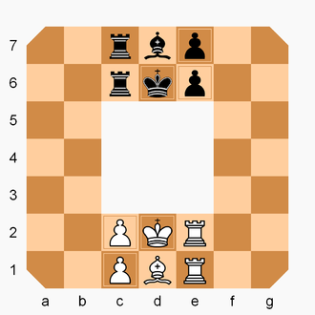

Rollerball

Slide 4
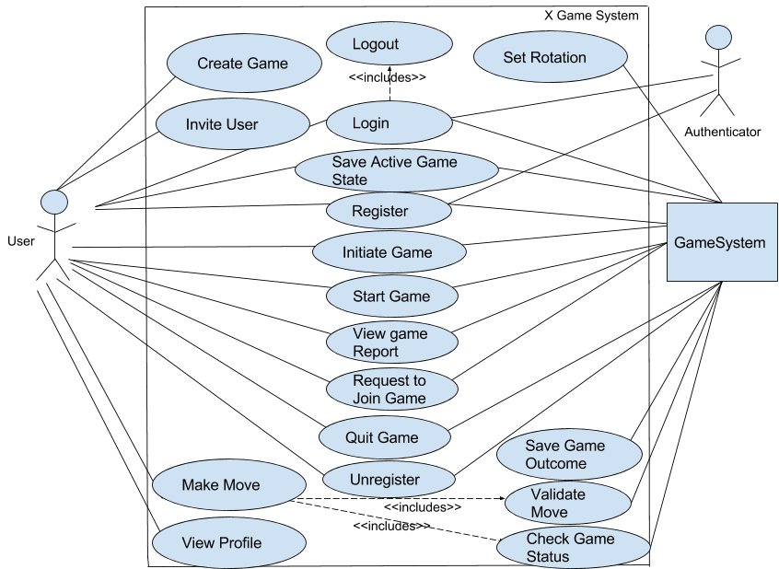
Old Use Case Diagram

Slide 5
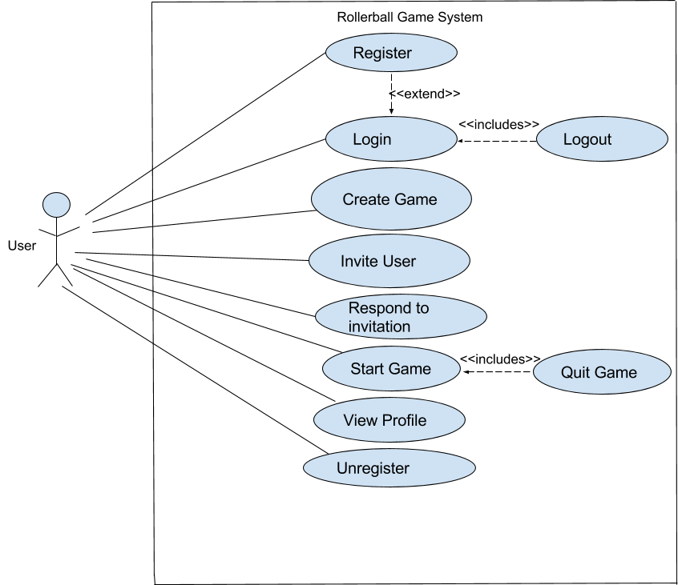
Updated Use Case

Slide 6
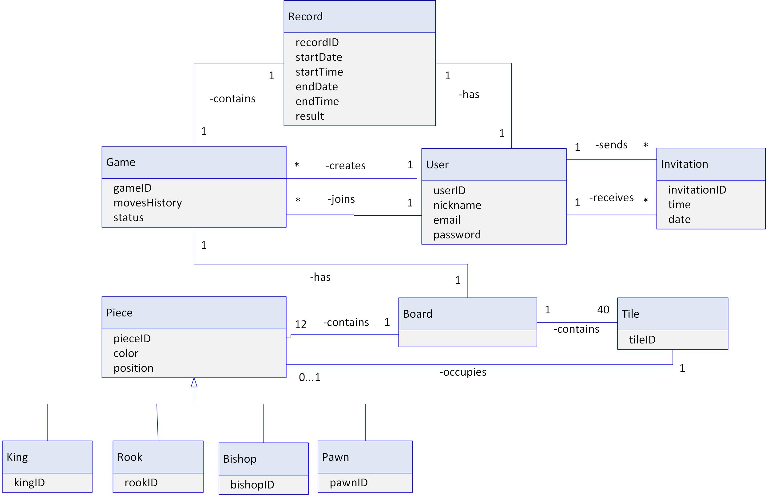
UML Class Diagram

Slide 7
Project Decisions
Configuration Class
Connect And Test Database
Test database
Stores Username, Email, and Password
MySQL DB

Slide 8

Questions

Slide 9
Rollerball

Slide 10
Old Use Case Diagram

Slide 11
Updated Use Case

Slide 12
UML Class Diagram

Slide 13
Project Decisions
Configuration Class
Connect And Test Database
Test database
Stores Username, Email, and Password
MySQL DB

Slide 14
Questions

